Slide 1


Preliminary Design Review
FISH & CHIPS FeatherCraft Integrated Structural Housing & Computer, Hardware Information Processing Suite
Team: Larry Burkey, Jorge Cervantes, Lewis Gilis, Evan Graser, Andrei Iskra,
Megan Howard, Taylor Maurer, Davis Peterson, Maggie Williams
Customer: Michael Brown
Advisor: Joe Tanner

Slide 2
PROJECT MOTIVATION
Commercialization of International Space Station provides a launch opportunity not only to cubesats but larger 100 kg spacecraft
Spacecraft are launched on ISS cargo resupply missions, allowing for soft-stowed configuration and less stress on structure in launch environment
Surrey Satellite Technology US plans to offer the FeatherCraft system as a cost-effective platform for payloads of 45 kg or less.
Project Overview
Structure
Electrical Hardware
Software
Testing
Conclusion

Slide 3
PROJECT STATEMENT:
The 5 kg FeatherCraft structure shall provide support for a 100 kg total mass commercial spacecraft with reduced structural manufacturing time and materials cost, and enable the spacecraft to survive launch to and deployment from the ISS for a nadir facing mission.
Project Overview
Structure
Electrical Hardware
Software
Testing
Conclusion

Slide 4
CONOPS:
.
1. Select suitable lightweight material and create design for structure
2. Fabricate structural test model
3. Design and build data acquisition system to verify structure’s behavior is as modeled
4. Test structural test model on a vibration table with mass loadings
5. Analyze accelerometer data and verify requirements are met
Project Overview
Structure
Electrical Hardware
Software
Testing
Conclusion

Slide 5
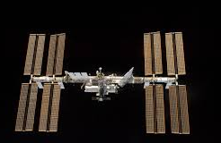
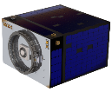


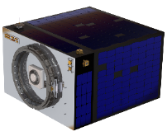
CONOPS:
1. Select suitable lightweight material and create design for structure
2. Fabricate structural test model
3. Design and build data acquisition system to verify structure’s behavior is as modeled
4. Test structural test model on a vibration table with mass loadings
5. Analyze accelerometer data and verify requirements are met
9. Interface with the Kaber Deployment System and deploy from the JEM airlock
10. Possible Orbit Raising
Maneuver and 5 year mission lifetime
6. Final testing and integration with avionics and other bus components
7. Integrate with payload and ISS resupply vessel
8. Launch to ISS
Project Overview
Structure
Electrical Hardware
Software
Testing
Conclusion

Slide 6
FUNCTIONAL BLOCK DIAGRAM:
KEY
Voltage to Power Spectral Density Conversion
DAQ System
Acquired
Real time Data Display and Limit checking
Designed and Built
Structure Design
Data Analysis Program- displaying trends, sorting files by test run, and identifying anomalies
Provided
3-axis Accel
3-axis Accel
3-axis Accel
Realtime data
Designed
Accel Channels
Accel Voltages
Payload and avionics mass simulators
Raw Data Files
Structural test Model
Stored data
ON/OFF data collection switch and grms limit violation parameters
Data files transferrable via USB and importable into Excel
Propulsion Plate mass simulator
Vibe Table
ON/OFF Vibe switch
Data storage system
User Input
Project Overview
Structure
Electrical Hardware
Software
Testing
Conclusion

Slide 7
FUNCTIONAL REQUIREMENTS:
FR 1 | The Feathercraft structure design shall be lightweight.
FR 2 | The Feathercraft structure design shall reduce manufacturing time and material cost from SST-US’s typical spacecraft estimates.
FR 3 | FeatherCraft Structure shall be designed to withstand a vibration table setting of 9.47 grms in soft-stowed configuration.
FR 4 | FeatherCraft Structure shall be designed to deploy from the Kaber Deployment Service.
FR 5 | FeatherCraft structure design shall interface with STS-US-provided spacecraft components and mission design.
FR 6 | An equivalent manufactured STM of the FeatherCraft structure design shall be used to demonstrate the feasibility of the FeatherCraft structure through a random vibration test to the requirements of SSP 50835.
Project Overview
Structure
Electrical Hardware
Software
Testing
Conclusion

Slide 8
Structure Overview

Slide 9

DESIGN OVERVIEW:
Solar Panels
Radiator
Propulsion Plate
(Aerojet Rocketdyne)
Nadir facing payload
Project Overview
Structure
Electrical Hardware
Software
Testing
Conclusion

Slide 10
DESIGN OVERVIEW:
Extruded Carbon Fiber Columns
Carbon Fiber/
Aluminum Honeycomb Sandwich Panels
Customer-supplied
propulsion plate supports 12 kg propulsion unit
Tabbed interlocks allow easy integration
19 in
All structural components are bonded together to avoid fasteners
Middle plate supports
78 kg Avionics & Payload
30 in
30 in
Project Overview
Structure
Electrical Hardware
Software
Testing
Conclusion

Slide 11
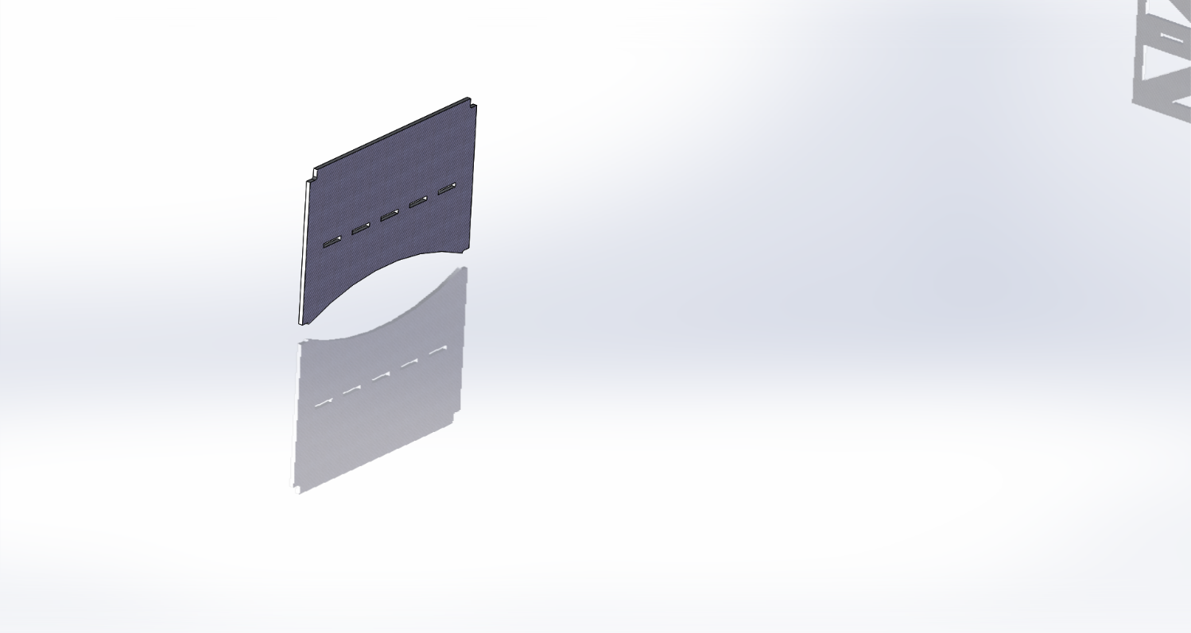
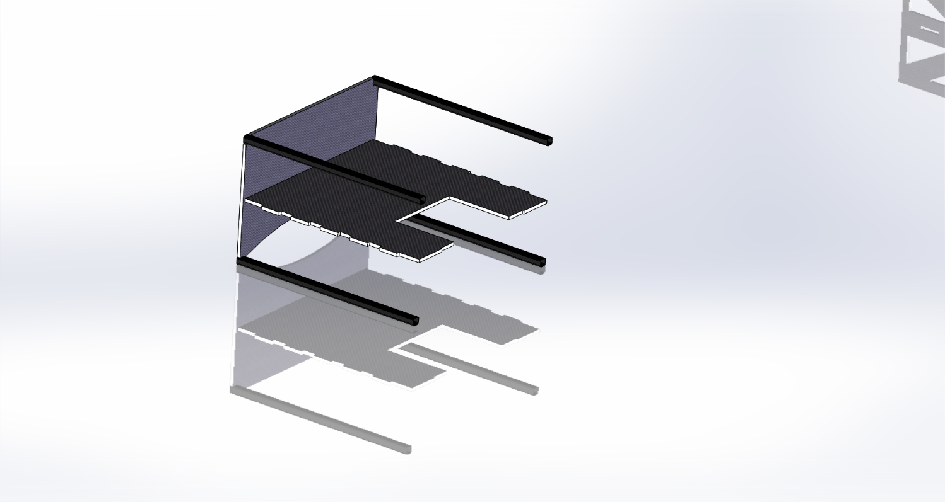
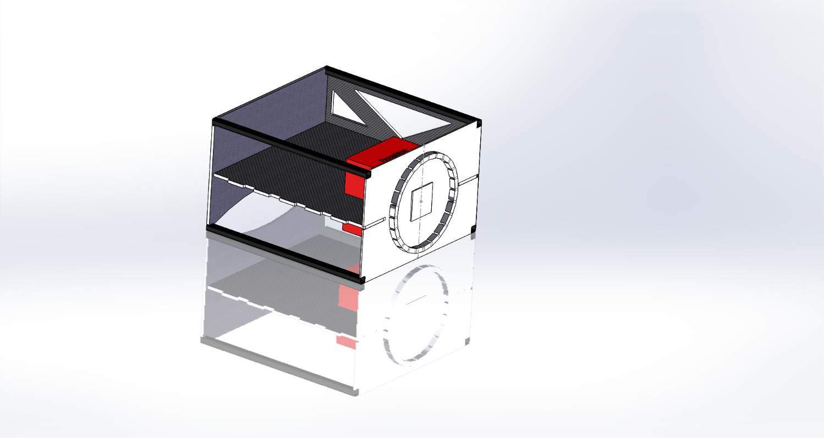
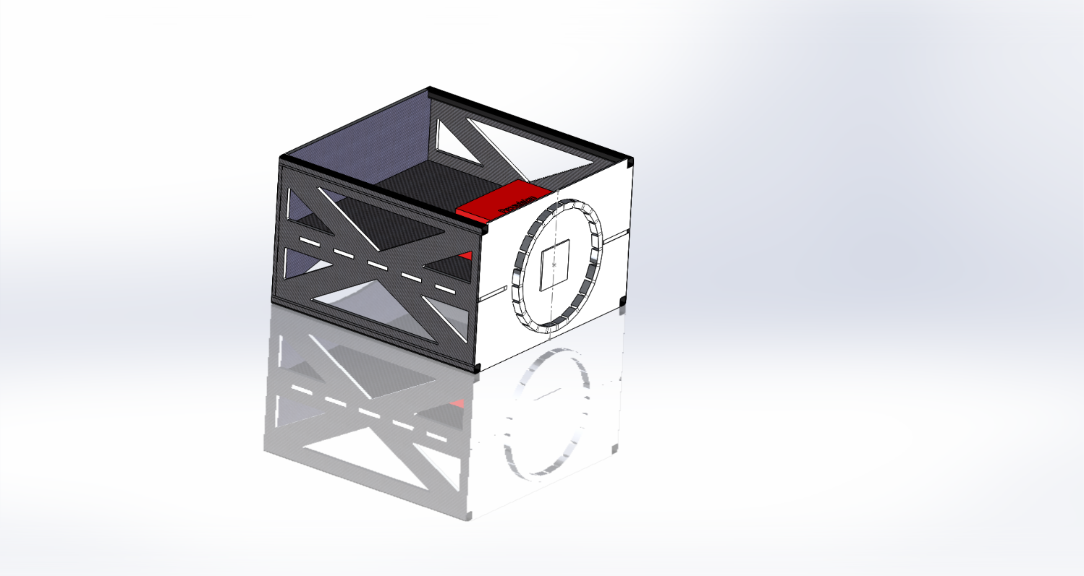
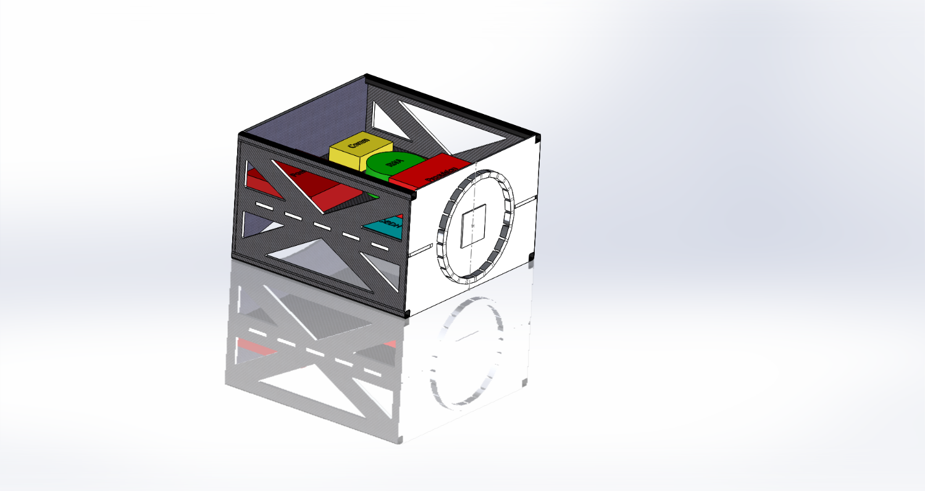
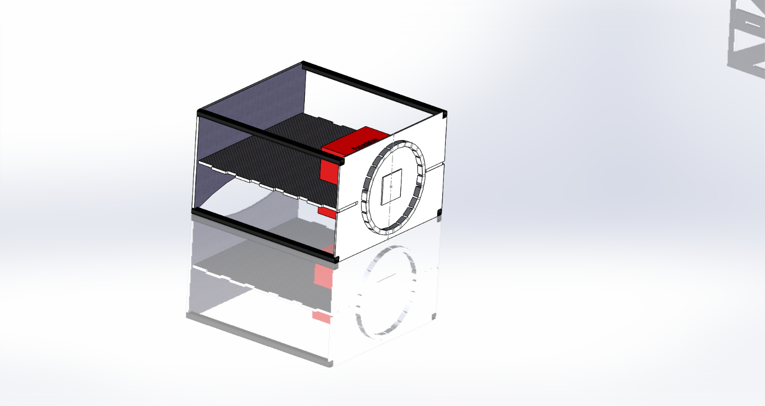
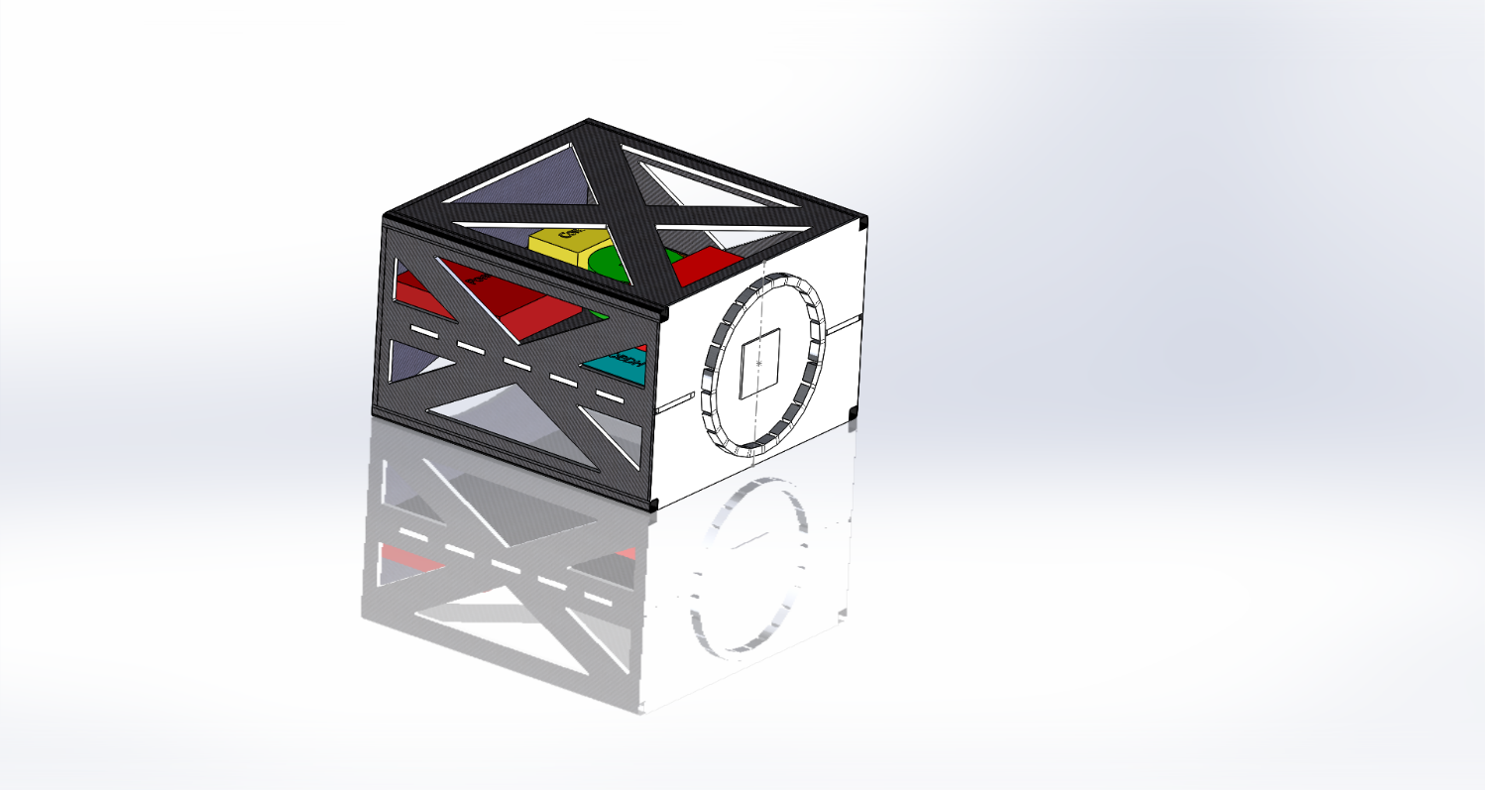
ASSEMBLY:
Integrate with
Avionics and Payload
Finish with
Upper Plate
Start with Back Panel
Side Panels bond on
Side Panels bond on
Add Middle Plate and Corner Columns
Propulsion plate
and Propulsion unit
Bond on Solar Panels to finish satellite integration
Corner Joints bonded with overlapping face sheets
Project Overview
Structure
Electrical Hardware
Software
Testing
Conclusion

Slide 12
Structure Feasibility

Slide 13
Structure Feasibility
Materials are chosen to optimize mass
and maximize stiffness
Feasible design will comply with mass requirement
Structure will handle specified vibration tests
Preliminary calculations assume quasi-static load
Nominal average acceleration 1σ = 1.29 g (rms)

Slide 14
Quasi-static load:
Assume: static load 1.4 g and 4σ dynamic load
F = m*a
F =M*g*1.4 + M*(4*1.29*g)
M = 100 kg; g = 9.81 m/s2
F = 6.9 kN
Project Overview
Structure
Electrical Hardware
Software
Testing
Conclusion

Slide 15
VIBRATION LOADING:
Major interfaces are analyzed to survive worst-case loading
Axis: | Description: | Type of load: | Design Margin:
X | Tube – Plate | Shear | 5
 | Column | Buckling | 1
Y | Column | Bending | 6
 | Side panel | Bending | TBD
Z | Middle panel | Bending | 500
 | Mid panel tabs | Shear | 10
Next:
Finite Element Model (FEM) analysis shall identify areas of max stress
Natural frequency shall be estimated
Detailed analysis for CDR
Project Overview
Structure
Electrical Hardware
Software
Testing
Conclusion

Slide 16
ADHESIVES:
Using adhesive for attaching all components and structure
Worst loading case is 79.4 kPa
Total adhesive surface area with a 0.005 in thickness yields ~0.25 qrt
Picture of components on midplate
Project Overview
Structure
Electrical Hardware
Software
Testing
Conclusion

Slide 17
ADHESIVES:
Property (25⁰C) | Hysol EA 9394 | Scotch-Weld 2216
Tensile Lap Shear | 28.9 MPa | 22.1 MPa
Tensile Strength | 46 MPa
Compressive Strength | 158.6 MPa
Density | 1360 kg/ | 1330 kg/
Mass needed | 0.288 kg | 0.282 kg
Hysol EA 9394 Aerospace Adhesive
Customer recommended
1 qrt attainable at skygeek.com – $184.89
1 qrt attainable at chemcenters.com - $210.00
Bonded in composites lab, curing takes 24 hours with support tooling with full strength attained after 3-5 days
Scotch-Weld 2216 Epoxy
Customer recommended, can be removed with heat
1 qrt attainable at amazon.com – $275.74
1 qrt attainable at ellsworth.com - $282.58
Handling strength at 10 hours, cured for 7 days
Both have strength significantly higher than required for component mounting (79.4 kPa)
Project Overview
Structure
Electrical Hardware
Software
Testing
Conclusion

Slide 18
MASS BUDGET:
Mass Limit: 5kg
Mass of Design: 4.7kg
Project Overview
Structure
Electrical Hardware
Software
Testing
Conclusion

Slide 19
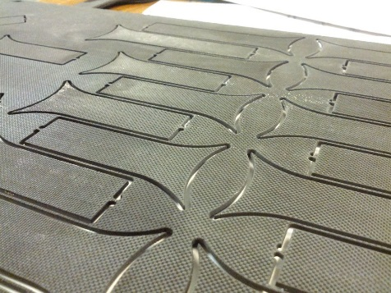
MANUFACTURING:
30 in
Most weight relief and support tabs are 2D
Achievable with Water Jet Cutter
Available at the Physics machine shop
Min. Radius = .006”
Positional Tolerance < .005”
Panel edges still need milling
Challenging
19 in
t = ½ in
Project Overview
Structure
Electrical Hardware
Software
Testing
Conclusion

Slide 20
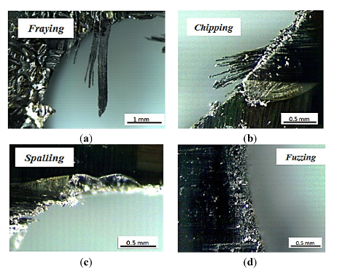
MANUFACTURING:
Machining of Panel Edges
Required allow overlap of face sheet
Fiber layer will likely fray and delaminate from core.
Design options still being weighed
t = ½ in
Experimental Analysis of the Influence of Drill Point Angle
and Wear on the Drilling of Woven CFRPs (Feito, 2014)
Project Overview
Structure
Electrical Hardware
Software
Testing
Conclusion

Slide 21
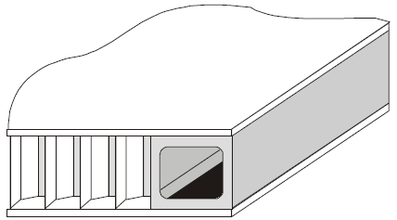
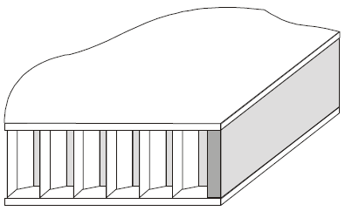
EDGE CLOSE OUT:
Box Extrusion:
Epoxy Fill In:
Use end mill or router table with a fly cutter to clear core
Used where panels interface with columns
Use block to push core back from edge
Fill with Loctite TF 3056FR
Project Overview
Structure
Electrical Hardware
Software
Testing
Conclusion

Slide 22
RADIATOR FEASIBILITY:
Requirement: Use one 19” x 30” panel of the structure as a radiator capable of dissipating 100 W
Back of the Envelope performed using Stefan Boltzmann Law
Assumptions:
Radiator panel is facing deep space (T∞ = 4 K)
Panel temperature ~25°C (nominal operating temperature)
Project Overview
Structure
Electrical Hardware
Software
Testing
Conclusion

Slide 23
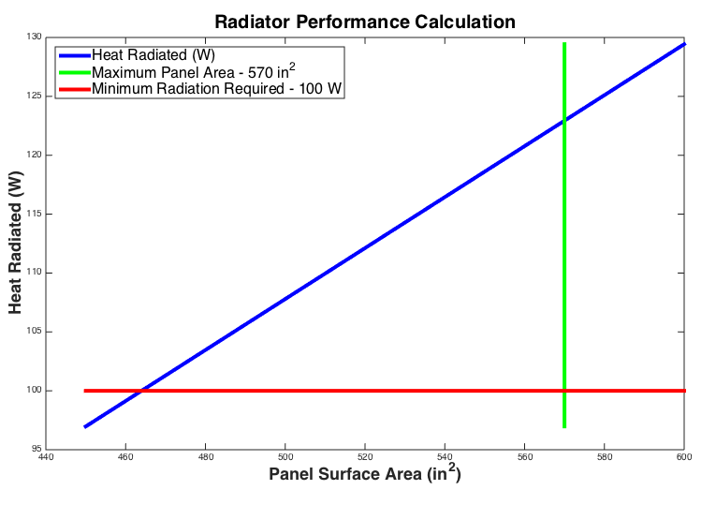
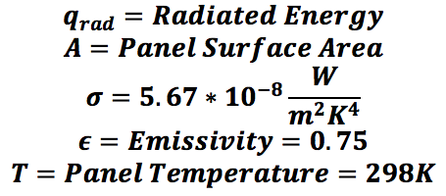
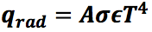
RADIATOR FEASIBILITY:
Proof of Feasibility and Area Calculation
Thermal Radiation – Stefan-Boltzmann Law
Variable Definitions and Values:
ε_{C}
T
q_{rad}
Calculated Radiator Panel Surface Area: 460 in²
Project Overview
Structure
Electrical Hardware
Software
Testing
Conclusion

Slide 24
Testing OVERVIEW

Slide 25
Test Facility:
Facility: Cascade Tek
1530 Vista View Dr, Longmont, CO (~30min)
Cost: $1800 for 8 hour use of Vibration Table
Currently factored into budget, may be donated by Surrey
May require less than 8 hours, requires preliminary testing
Testing will occur in March with direct assistance from Cascade Tek test engineers
Project Overview
Structure
Electrical Hardware
Software
Testing
Conclusion

Slide 26
Random Vibration Test:
Profile specified by NASA Document:
ISS Pressurized Volume Hardware Common Interface Requirements
Random Vibration Profile Characteristics
20 Hz. – 2000 Hz. Frequency Range
Random vibration loads specified for different frequencies
Maximum Unattenuated Flight Envelope: 9.47 grms
Maximum Attenuated Flight Envelope: 1.29 grms
Project Overview
Structure
Electrical Hardware
Software
Testing
Conclusion

Slide 27
Testing feasibility

Slide 28
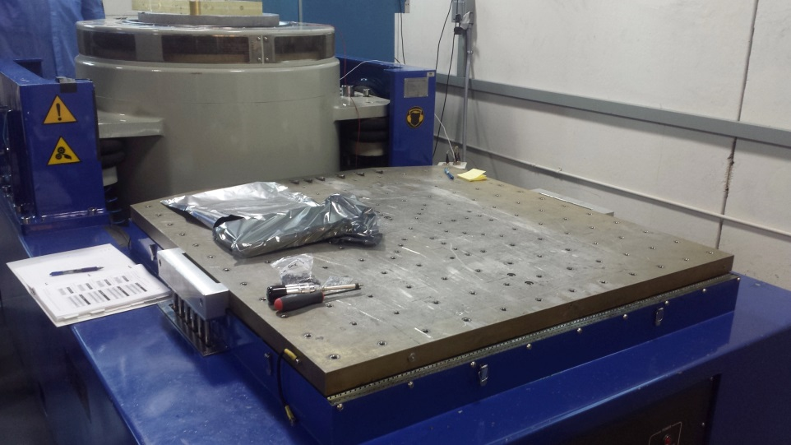
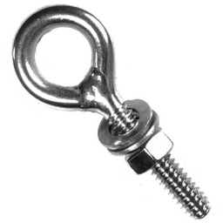
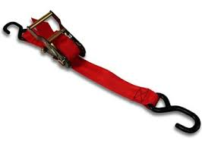
Structure Mounting:
Structure will be wrapped in specified SECO-88 Bubble Wrap
Attenuates Vibration Loading
Two ratchet straps will secure the structure to the table
Hooked to ½” by 13 eyebolts (4), bolted directly to vibration table
Project Overview
Structure
Electrical Hardware
Software
Testing
Conclusion

Slide 29
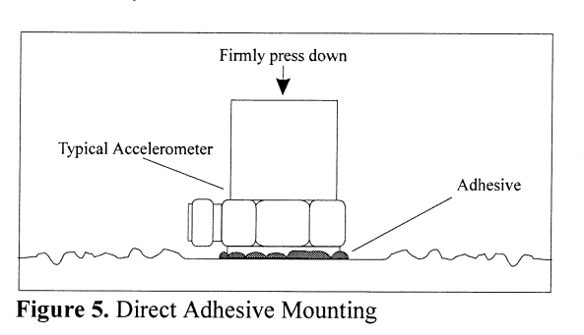
ACCELEROMETER MOUNTING:
Stiff adhesive recommended by manual
Superglue applied to bottom and pressed onto structure
Signal transfer via shielded coaxial cable
Project Overview
Structure
Electrical Hardware
Software
Testing
Conclusion

Slide 30
Electrical Hardware OVERVIEW

Slide 31
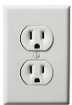


DAQ HARDWARE FBD:
KEY
PC with Windows OS
(not delivered)
Digital
Analog
Power
Software
Data Acquisition Board
Micro
Controller
Board
8-input S/H
ADC
5V
Real-time Display
Accel Channels (x8)
Signal Conditioning
5V
Switch
Parallel Bit
Data Bus
5V
Delivered $↑$
Designed $↓$
Processor
Power
Supply
Data Acquisition Board
24V
Accel Channels (x8)
Signal Conditioning
8-input S/H
ADC
Hard Drive
Data Acquisition Board
120VAC
60 Hz
(wall outlet)
Accel Channels (x8)
Signal Conditioning
8-input S/H
ADC
USB Drive with DAQ Software
Replicate DAQ Boards for 60 Channels
Project Overview
Structure
Electrical Hardware
Software
Testing
Conclusion

Slide 32
Electrical Hardware FEASIBILITY

Slide 33
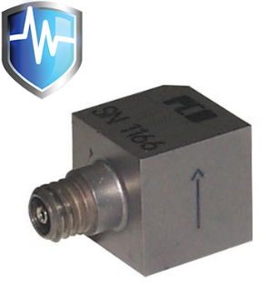
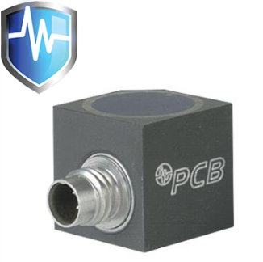
ACCELEROMETERS:
Resources:
Trudy Schwartz
Christine Buckler (ITLL) for barrowing accels and cables
The Modal Shop for renting accels for 30 days
Single Axis (PCB-333B30)
Tri-axial (PCB-356A16)
Accelerometer | Buy | Rent
Single axis | $297 | $60/ month
Tri-axial | $931.50 | $200/ month
Project Overview
Structure
Electrical Hardware
Software
Testing
Conclusion
Notes:
Pictures from PCB.com

Slide 34
ELECTRONICS SYSTEM:
Project Overview
Structure
Electrical Hardware
Software
Testing
Conclusion

Slide 35
SIGNAL CONDITIONING:
Cost for Signal Conditioning:
Printed Boards: PCB boards for $83, Advanced Circuits
Assembly: Soldering Microcontroller for $X, Advanced Circuits
Power Supply: $150 from Newark (BK 1550)
Rest of the components: $3.00 per board
Project Overview
Structure
Electrical Hardware
Software
Testing
Conclusion

Slide 36
SIGNAL CONDITIONING:
Cost for the rest of the Signal Conditioning circuit:
Resistors, Diodes & Capacitors: ~$1.50 per board
Operational Amplifier: $0.70 each on Mouser
Project Overview
Structure
Electrical Hardware
Software
Testing
Conclusion

Slide 37
CIRCUIT:
Resources for Circuits:
Trudy Schwartz and the Instrumentation Shop
TIRESIAS project involved a similar accelerometer circuit
PCB Piezoelectric and ADC manuals for circuit designs
Altium Designer software available for student use
PCB Designer Software through Advanced Circuits available
Project Overview
Structure
Electrical Hardware
Software
Testing
Conclusion

Slide 38
DATA TRANSFER TO PC:
KEY
Micro
Controller
(dsPIC33)
All channels sample and hold simultaneously by toggling convert pin
Chip Select
I/O
Cmnd
Data
Logic
S/H – ADC (AD7606)
Convert
Chip Select
I/O
64-channel
simultaneous
sampling (200 KHz)
from charge amplifiers
S/H – ADC (AD7606)
USB to PC
Parallel Bit
Data Bus
Convert
S/H – ADC (AD7606)
Chip Select
I/O
I/O
Convert
5 More ADCs
Project Overview
Structure
Electrical Hardware
Software
Testing
Conclusion

Slide 39
DATA TRANSFER TO PC:
KEY
Micro
Controller
(dsPIC33)
First 8 data channels collected and stored.
Chip Select
I/O
Cmnd
Data
Logic
S/H – ADC (AD7606)
Convert
Chip Select
I/O
64-channel
simultaneous
sampling (200 KHz)
from charge amplifiers
S/H – ADC (AD7606)
USB to PC
Parallel Bit
Data Bus
Convert
S/H – ADC (AD7606)
Chip Select
I/O
I/O
Convert
5 More ADCs
Project Overview
Structure
Electrical Hardware
Software
Testing
Conclusion

Slide 40
DATA TRANSFER TO PC:
KEY
Micro
Controller
(dsPIC33)
Second 8 data channels collected and stored.
Chip Select
I/O
Cmnd
Data
Logic
S/H – ADC (AD7606)
Convert
Chip Select
I/O
64-channel
simultaneous
sampling (200 KHz)
from charge amplifiers
S/H – ADC (AD7606)
USB to PC
Parallel Bit
Data Bus
Convert
S/H – ADC (AD7606)
Chip Select
I/O
I/O
Convert
5 More ADCs
Project Overview
Structure
Electrical Hardware
Software
Testing
Conclusion

Slide 41
DATA TRANSFER TO PC:
KEY
Micro
Controller
(dsPIC33)
Next 8 data channels collected and stored.
Chip Select
I/O
Cmnd
Data
Logic
S/H – ADC (AD7606)
Convert
Chip Select
I/O
64-channel
simultaneous
sampling (200 KHz)
from charge amplifiers
S/H – ADC (AD7606)
USB to PC
Parallel Bit
Data Bus
Convert
S/H – ADC (AD7606)
Chip Select
I/O
I/O
Convert
5 More ADCs
Project Overview
Structure
Electrical Hardware
Software
Testing
Conclusion

Slide 42
DATA TRANSFER TO PC:
KEY
Micro
Controller
(dsPIC24/33)
Data sets transmitted to PC together
Process repeats
Chip Select
I/O
Cmnd
Data
Logic
S/H – ADC (AD7606)
Convert
Chip Select
I/O
64-channel
simultaneous
sampling (200 KHz)
from charge amplifiers
S/H – ADC (AD7606)
USB to PC
Parallel Bit
Data Bus
Convert
S/H – ADC (AD7606)
Chip Select
I/O
I/O
Convert
5 More ADCs
Project Overview
Structure
Electrical Hardware
Software
Testing
Conclusion

Slide 43
Software OVERVIEW

Slide 44
DESIGN:
Python, packaged as executable (.exe)
GUI created for user input
Implement already created python modules and libraries
Plot quasi-real-time PSD (power spectral density) plots
Capability of saving data to excel (.xls)
Project Overview
Structure
Electrical Hardware
Software
Testing
Conclusion

Slide 45

External Computer (Windows)
USB
Already existing
.exe
Need to be built
Active data flow
User controlled
Project Overview
Structure
Electrical Hardware
Software
Testing
Conclusion
Notes:
0. This is the external computer where data is saved and displayed. Right now

Slide 46
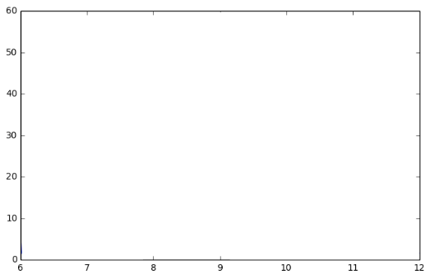
External Computer (Windows)
GUI
Start/stop
Limits
Save file location
Channel #
USB
Serial port interface module
Already existing
PSD Plots
Need to be built
Active data flow
User controlled
Project Overview
Structure
Electrical Hardware
Software
Testing
Conclusion
Notes:
2. After this the user will be able to enter limits, the save file location and channel number with a maximum of 60 channels.

Slide 47
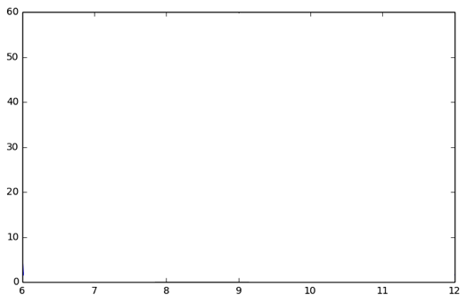
External Computer (Windows)
GUI
Start/stop
Limits
Save file location
Channel #
USB
Start
Serial port interface module
Already existing
PSD Plots
Need to be built
Active data flow
User controlled
Project Overview
Structure
Electrical Hardware
Software
Testing
Conclusion
Notes:
3. User then presses start to tell the microcontroller to initiate the data collection.

Slide 48
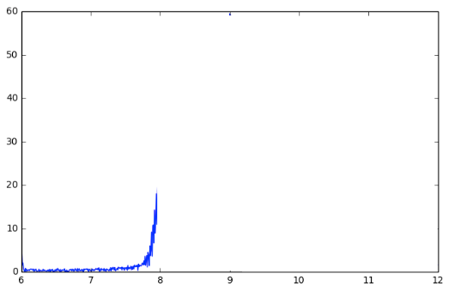
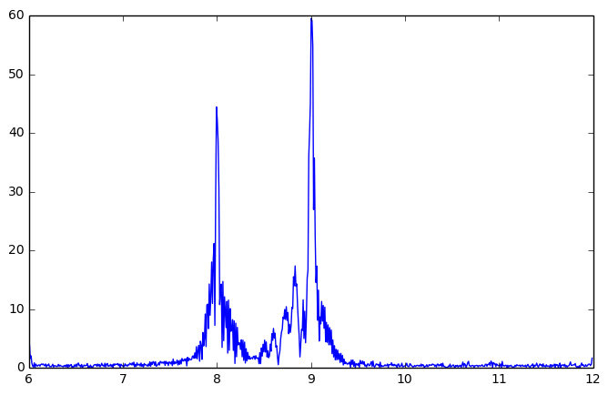
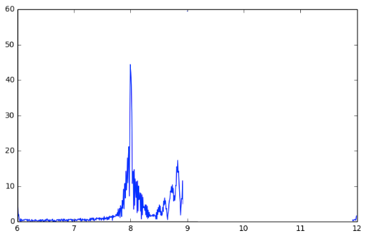
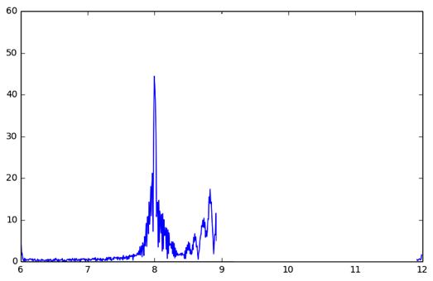
External Computer (Windows)
GUI
Start/stop
Limits
Save file location
Channel #
USB
Start
Serial port interface module
Already existing
PSD Plots
Need to be built
Limit Checking
Active data flow
Raw Data Storage
User controlled
FFT
Project Overview
Structure
Electrical Hardware
Software
Testing
Conclusion
Notes:
3. This initiates the data collection, moving through limit checking, data storage, and the FFT. At this realtime data starts to populate the real-time plot.

Slide 49
External Computer (Windows)
GUI
Start/stop
Limits
Save file location
Channel #
USB
Stop
Serial port interface module
Already existing
PSD Plots
Need to be built
Limit Checking
Active data flow
Raw Data Storage
User controlled
FFT
Project Overview
Structure
Electrical Hardware
Software
Testing
Conclusion
Notes:
4. Once data collection is finished, user will press stop, halting the communication from the microcontroller and the realtime plotting.

Slide 50
External Computer (Windows)
GUI
Start/stop
Limits
Save file location
Channel #
USB
Stop
Serial port interface module
Already existing
PSD Plots
Need to be built
“Save report? (Y/N)” Query
Limit Checking
Active data flow
Raw Data Storage
Export to Excel ‘.xls’
User controlled
FFT
Project Overview
Structure
Electrical Hardware
Software
Testing
Conclusion
Notes:
4. Once data collection is finished, user will press stop, halting the communication from the microcontroller and the realtime plotting.

Slide 51
External Computer (Windows)
GUI
Start/stop
Limits
Save file location
Channel #
USB
Stop
Serial port interface module
Already existing
PSD Plots
Need to be built
“Save report? (Y/N)” Query
Limit Checking
Active data flow
Raw Data Storage
Export to Excel ‘.xls’
User controlled
FFT
Project Overview
Structure
Electrical Hardware
Software
Testing
Conclusion
Notes:
4. Once data collection is finished, user will press stop, halting the communication from the microcontroller and the realtime plotting.

Slide 52
External Computer (Windows)
GUI
Start/stop
Limits
Save file location
Channel #
USB
Stop
Serial port interface module
Already existing
PSD Plots
Need to be built
“Save report? (Y/N)” Query
Limit Checking
Active data flow
Raw Data Storage
Export to Excel ‘.xls’
User controlled
FFT
Project Overview
Structure
Electrical Hardware
Software
Testing
Conclusion
Notes:
4. Once data collection is finished, user will press stop, halting the communication from the microcontroller and the realtime plotting.

Slide 53
Software FEASIBILITY

Slide 54
Python Libraries Available:
Serial interface
PySerial
FFT function
NumPy
Excel implementation
xlwings, xlsxwriter
PSD plotting
matplotlib
Executable packager
cx freeze
GUI Development
Qt, tkinter
All libraries existence has been confirmed
Project Overview
Structure
Electrical Hardware
Software
Testing
Conclusion

Slide 55
NEXT STEPS - SOFTWARE:
All tools needed are downloadable and installable
Need to find out how they work – possible limitations
If time allows start creating example scripts using new libraries
Start becoming familiar with python
Some team members may need earlier start than others
Project Overview
Structure
Electrical Hardware
Software
Testing
Conclusion

Slide 56
CONCLUSION

Slide 57
BUDGET:
Total Budget: $5000, Total Desired:$6277
Project Overview
Structure
Electrical Hardware
Software
Testing
Conclusion

Slide 58
PATH MOVING FORWARD :
Numeric Modeling
Familiarization with Python
Circuits?
EEF Award?
Vibe Testing Donation?
Final Component & Material Selection
Small Scale Component Testing
Software Development an Framework
Detailed Circuit Development
Project Overview
Structure
Electrical Hardware
Software
Testing
Conclusion

Slide 59
Back-up Slides

Slide 60
Requirements: FR1
FR 1: The FeatherCraft structure design shall be lightweight.
DR 1.1: Structural design mass shall be less than 5 kg.
Source: Customer requirement. Increasing the structural mass beyond 5 kg would prevent SST-US from providing a profitable weight class of payloads
Verification: Modeling and analysis, comparison with measurement of STM

Slide 61
Requirements: FR2
FR 2: The Feathercraft structure design shall reduce manufacturing time and material cost from SST-US’s typical spacecraft estimates.
DR 2.1: Structure design material cost shall be less than $20,000.
Source: Customer requirement, SST-US typically expends $40,000 on a spacecraft material and this design shall reduce that metric by 50%.
Verification: Budget analysis
DR 2.2: Structure design manufacturing and assembling shall take less than 9 months.
Source: Customer requirement, SST-US typically spends 18 months on spacecraft manufacturing and assembling and this design shall reduce that metric by 50%.
Verification: Manufacturing estimates and analysis
DR 2.3: Structure design manufacturing and building labor shall cost less than $80,000.
Source: Customer requirement. This is a 50% reduction of SST-US’s typical manufacturing and building cost of $160,000 and will help the company meet the goal total price of $6 million.
Verification: Budget estimates and analysis

Slide 62
Requirements: FR3
FR 3: FeatherCraft Structure shall be designed to withstand a vibration table setting of 9.47 grms in a soft-stowed configuration.
DR 3.1: FeatherCraft structure in launch configuration shall be designed to not be damaged by simulated launch environment, up to a 9.47 grms random vibration environment with safety factors as outlined in the GEVS ISS Pressured Volume Hardware Common Interface Requirements Document Rev C.
Source : Customer requirement. To remain profitable, the FeatherCraft package needs to be reliable and provide a robust platform for their customers, as well as meet all NASA requirements for launch to the ISS.
Verification: Vibration test executed on STM in FR 6 and measurement of STM before and after vibration test

Slide 63
Requirements: FR4
FR 4: FeatherCraft Structure shall be designed to deploy from the Kaber Deployment Service.
DR 4.1 FeatherCraft structure design including mounted components shall fit within the volume of 30”x30”x19”.
Source: The spacecraft as a whole must be placed within the Kaber volume to be deployed and begin its mission. This volume ensures at least 2’’ of space between the spacecraft volume and the edge of the JEM airlock. Soft stowed as defined by GEVS ISS Pressured Volume Hardware Common Interface Requirements Document Rev C.
Verification: Inspection of drawings, demonstration with measurement

Slide 64
Requirements: FR5
FR 5: FeatherCraft structure design shall interface with SST-US-provided spacecraft components and mission design.
DR 5.1: FeatherCraft structure design shall provide mounting positions on the three sides of the structure for one 30’’x30’’x0.125’’ solar panels of mass 2 kg and two 30’’x18.976’’x0.125’’ solar panel of mass 1.5 kg.
Source: Customer requirement, knowing that this is a nadir-facing mission; the three sides that spend the most time facing the sun should have solar panels mounted on them. These sides will proven to always see sun through STK analysisare required by the customer to provide adequate power for interfacing components.
Verification: Modeling and analysis in STK, STM demonstration in FR 5.
DR 5.2: FeatherCraft structure design shall provide a mounting position for a 29.094’’x18.976’’x0.125’’ propulsion plate of mass 12 kg on Side 1.
Source: Customer requirement. The propulsion plate design has been finalized, and its dimensions necessitate its mounting location.
Verification: modeling and inspection of drawings, STM demonstration in FR 5
DR 5.3 FeatherCraft structure design shall have an internal structural component equally bisecting the 19’’ height dimension to provide mounting capabilities to the avionics components and payload components.
Source: Customer requirement. The mounting capabilities are necessary for the customer to assemble the spacecraft easily and safely. This bisecting structural component defines a payload bay and avionics bay so that a payload volume is defined for potential customers.
Verification: Inspection of drawings, Test (measure STM)

Slide 65
Requirements: FR5
DR 5.4 FeatherCraft structure design shall dissipate up to 100 W of heat generated equally by avionics and payload bays at an operating temperature of -20 to 50 degrees C.
Source: Customer requirement. The maximum power output is estimated by the customer to remain below 100W. The specifics of this analysis are presented in Section 4.1.4.
Verification: Analysis
DR 5.4.1: FeatherCraft structure design shall have a radiative material on the side facing deep space most often to dissipate heat.
Source: Customer requirement, derived from DR 5.4. This shall be determined in the same STK analysis that determines which sides of the spacecraft experience the most direct sunlight over a year.
Verification: Inspection of model, STK analysis
DR 5.5 FeatherCraft structure design shall keep side 5 open.
Source: Customer requirement, payload use and space for antenna(s) facing nadir.
Verification: modeling, demonstration in STM
DR 5.6 FeatherCraft structure design shall remain operational for five years in a space environment.
Source: Customer requirement, the spacecraft bus will be advertised as a five-year mission.
Verification: Analysis of structure material and assembly method for similarity to previous missions’ material heritage

Slide 66
Requirements: FR6
FR 6: A manufactured STM of the FeatherCraft structure design shall be used to validate the design through a modal vibration sweep and a random vibration test to the requirements of SSP 50835.
DR 6.1 STM shall be manufactured with sufficient similarity to the structural design such that it can be used for validation of the designed structure. It shall fulfill all of the requirements of the designed structure with the exception of the 5kg structural mass requirement, which may be exceeded.
Source: Customer requirement. A physical test must be performed to provide a baseline of feasibility; this can only be proved if the STM is similar to the design. However, the materials of the STM are constrained to the FeatherCraft team budget.
Verification: Analysis of materials
DR 6.2 STM shall be tested on a vibration table for a vibration profile of 20-2000 Hz and up to a vibration table setting of 9.47 grms with each test lasting 60 seconds.
Source: GEVS table 3.1.1.2.1.2.3.2-1 (Page 3-17 of ISS Pressured Volume Hardware Common Interface Requirements Document Rev C.) It is estimated by this document that with a vibration table setting of 9.47 grms, the bubble-wrapped structure should experience 1.29 grms.
Verification: Inspection of test plan, test

Slide 67
Requirements: FR6
DR 6.3 STM shall support loads through vibration testing that are equivalent to the required loading of the designed structure.
Source: Validation of FR 6
Verification: Demonstration
DR 6.3.1 STM shall have a provided mass analog propulsion plate of mass and size specified in 5.2 mounted to side 1
Source: Validation of DR 5.2 and FR 5.
Verification: Inspection
DR 6.3.2 STM shall have provided solar panel mass analog plates mounted on sides determined from DR 5.1 with mass and size specified in DR 5.1
Source: Validation of DR 5.1 and FR 6.
Verification: Inspection
DR 6.3.3 STM shall have an internal loading of 35 kg mounted inside the structure in the avionics bay to represent the avionics mass.
Source: Validation of DR 5.3 and FR 6. This is the total mass of all spacecraft components SST-US intends to place inside the avionics bay.
Verification: Measure mass, Inspection of drawings of vibration test configuration
DR 6.3.4 STM shall have an internal loading of 47.5 kg mounted inside the structure in the payload bay to represent the payload mass.
Source: Validation of DR 5.3 and FR 6. This is the SST-US provided estimate it will allow for payload mass.
Verification: Measure mass, inspection of drawings of vibration test configuration

Slide 68
Requirements: FR6
DR 6.4: STM shall be wrapped in three layers of SECO 88 bubble wrap prior to testing.
Source: Customer Requirement stemming from ISS Pressured Volume Hardware Common Interface Requirements Document Rev C. The test shall be performed with the STM in the flight configuration.
Verification: Demonstration, inspection
DR 6.5 FEM model shall be verified using structural accelerometer information.
Source: Provides evidence for completion of FR 6 and allows data collection for later correlation to designed structure. The number of accelerometers necessary and their positons will be determined after the structural design is determined.
Verification: Analysis of FEM model, inspection of drawings of vibration test configuration

Slide 69
Requirements: FR6
DR 6.6 A data acquisition and analysis system shall be designed and created for this test and further tests of structural STMs to validate structural properties.
Source: Customer requirement, it will save the project money to own a data acquisition system, and this can be used for custom data collection and future tests
Verification: Demonstration
DR 6.6.1 Accelerometers determined by FR 6.5 shall be acquired for the testing of the STM, with one tri-axial accelerometer and one single-axis accelerometer retained by the design team.
Source: Customer requirement. The number of accelerometers needed to validate the FEM model will be determined by the structure shape, and SST-US would like one accelerometer to base an expanded data acquisition system on if they could acquire it at the end of the project.
Verification: Analysis of FEM model, demonstration
DR 6.6.2 DAQ shall contain 60 channels for the possibility of 20 tri-axial accelerometer inputs.
Source: Customer requirement, although the budget of the project limits the number of accelerometers to be used for the test in spring, future tests with 20 tri-axial accelerometers may be performed and data would be taken from all 20 at the same time.
Verification: Analysis of circuitry and inspection of design drawings

Slide 70
Requirements: FR6
DR 6.6.3: Accelerometer data shall display in the form of power spectral density plots during each test
Source: Customer requirement, safety for structure during test, real-time performance analysis
Verification: Demonstration
DR 6.6.4 Accelerometer data shall be saved during each test in an Excel-compatible format
Source: Customer requirement, post-test analysis
Verification: Demonstration
DR 6.6.5 Accelerometer data shall be transferable via USB from the microprocessor collecting data to any personal computer running Microsoft Windows operating systems.
Source: Customer Requirement. To prevent errors and wasted time, data should be easy to transfer to any of SST-US’ computers.
Verification: Demonstration

Slide 71
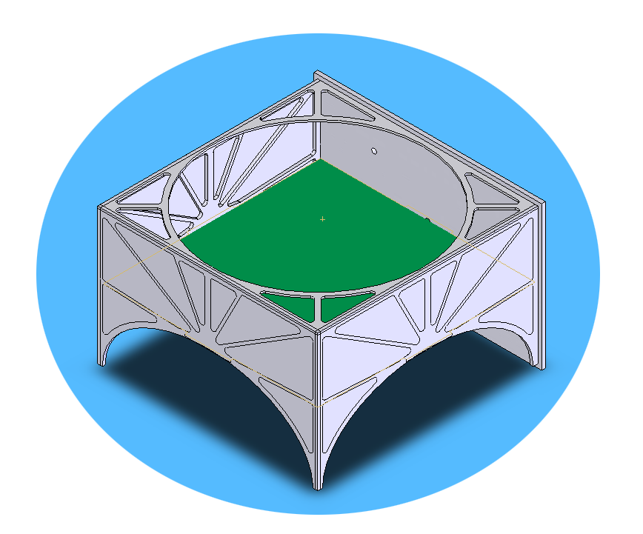
TRADITIONAL APPROACH:

Slide 72
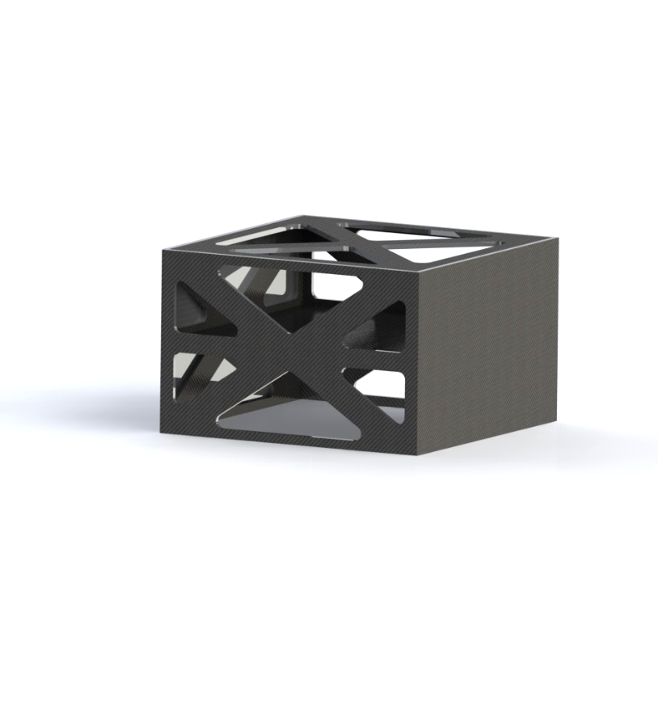
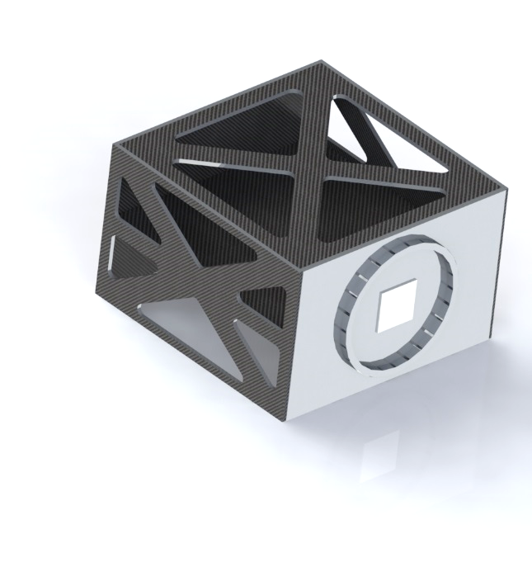
WEIGHT RELIEVED PANELS:

Slide 73
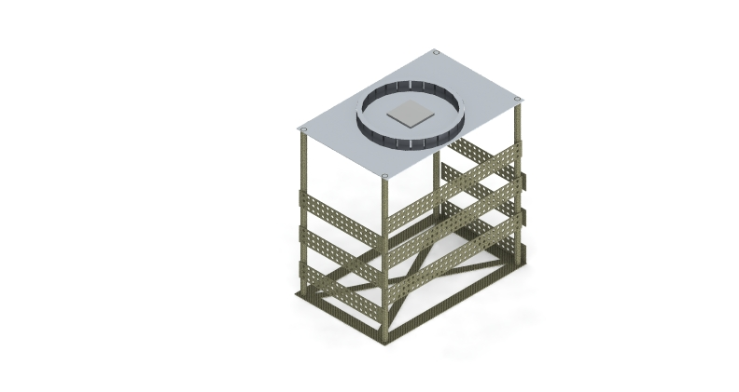
COLUMNS:

Slide 74
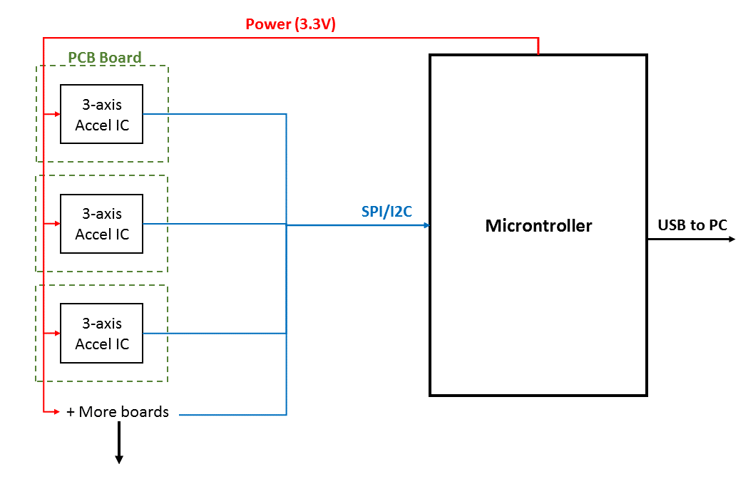
Digital Output Accelerometers:

Slide 75
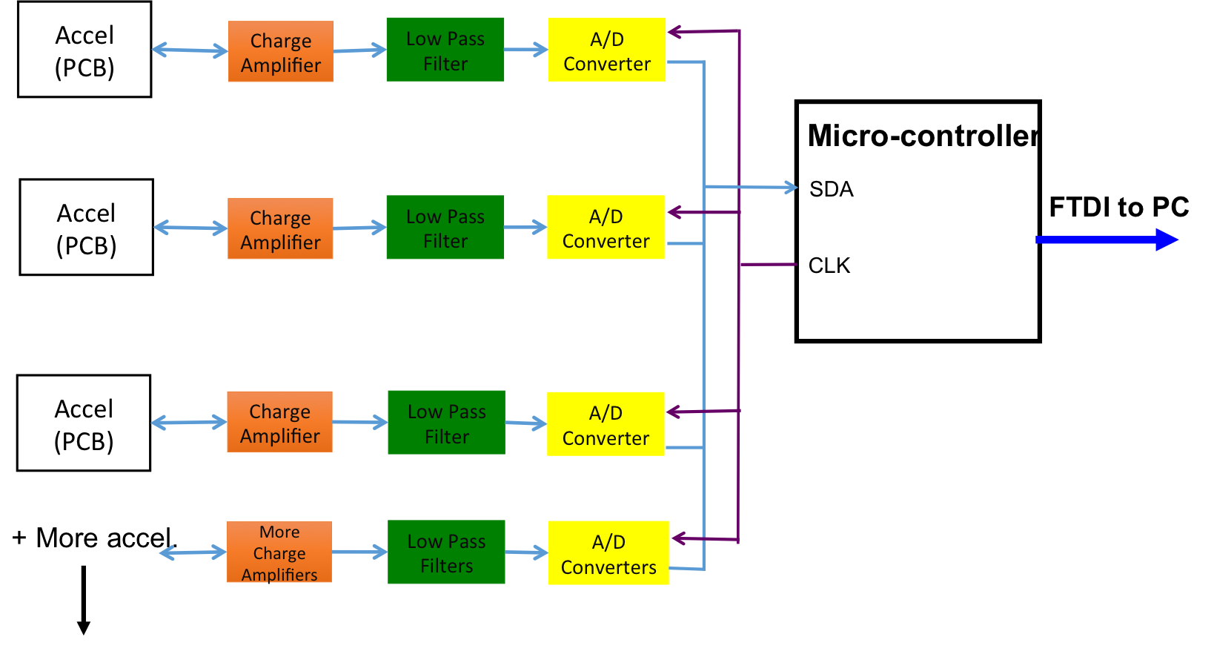
Build DAQ System w/ 1 Micro-Controller:

Slide 76
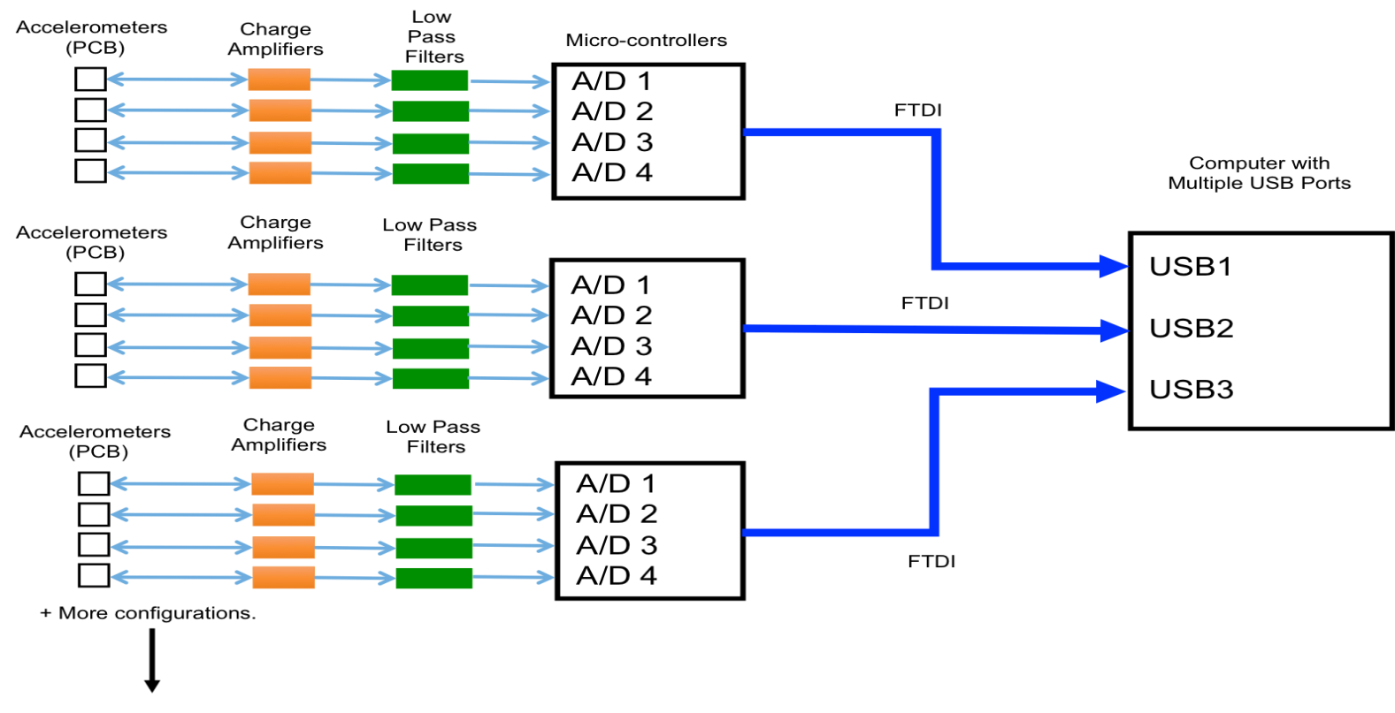
Build DAQ System w/ Multiple Micro-Controllers:

Slide 77
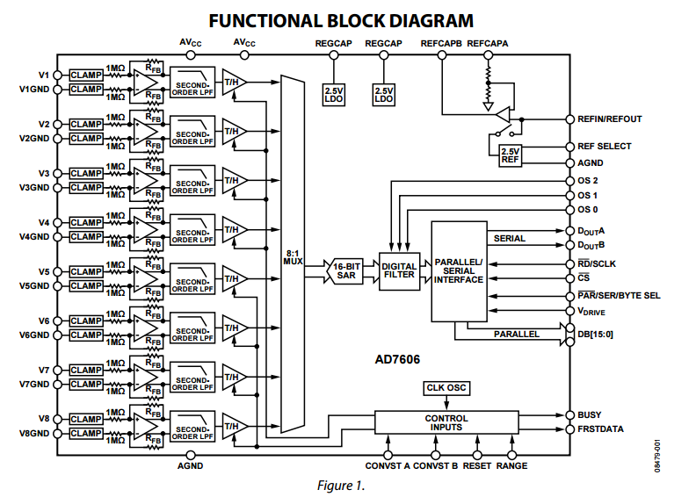
Analog to Digital Converter - FBD
- 16-bit simultaneous sampling
Bipolar input range 5V
Single 5V supply
Parallel port data output
Up to 200 kSPS on every channel

Slide 78
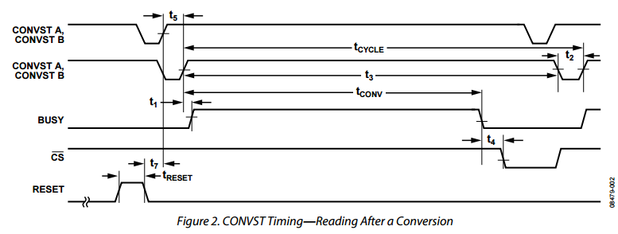
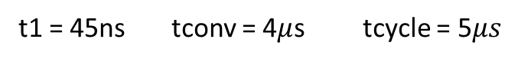
Analog to Digital Converter - Operation
t1 = 45ns tconv = 4$μ$s tcycle = 5$μs$

Slide 79
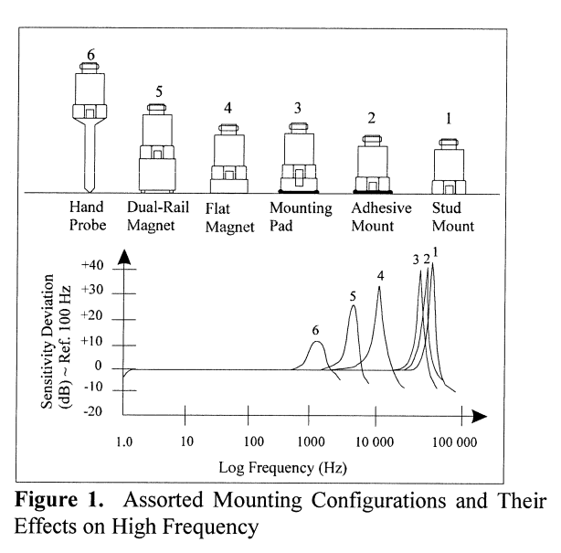
Accelerometer Mounting
Stud mounts impractical since they would require holes in structure

Slide 80
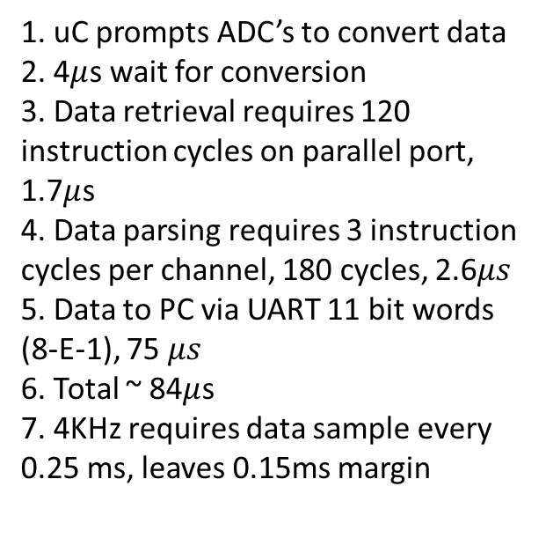
Data sampling speeds
uC features:
- 17.5Mbps UART
- Parallel Bit Data Port
- 70 mega instruction cycles per second
1. uC prompts ADC’s to convert data
2. 4$μ$s wait for conversion
3. Data retrieval requires 120 instruction cycles on parallel port, 1.7$μ$s
4. Data parsing requires 3 instruction cycles per channel, 180 cycles, 2.6$μs$
5. Data to PC via UART 11 bit words (8-E-1), 75 $μs$
6. Total ~ 84$μ$s
7. 4KHz requires data sample every 0.25 ms, leaves 0.15ms margin

Slide 81
Structure Trade Study – Metric Definitions:
 | 10 | 9 | 8 | 7 | 6 | 5 | 4 | 3 | 2 | 1
Material Cost: [kg] | 1 | 2 | 3 | 5 | 7.5 | 10 | 12.5 | 15 | 17.5 | 20
Mass [kg] | 4 | 5 | 5.5 | 6 | 6.5 | 7 | 7.5 | 8 | 9 | >10
Ease of Manufacturing: [hrs] | 10 | 20 | 30 | 40 | 50 | 60 | 70 | 80 | 90 | 100
Ease of Analysis: | A monkey could do it | Plug and play | Very little effort required | Little effort required | Some effort required | Neutral | Effort required | Much effort required | Too much effort required | I quit

Slide 82
Mechanical Design Trade Study:
 |  | Metalic Weight Relievd Panels | Honeycomb Weight-relieved Panels | Columns | Traditional Design
Criteria: | Weight: | Score: | Score: | Score: | Score:
Material Cost | 16% | 10 | 6 | 8 | 9
Mass | 35% | 2 | 10 | 9 | 2
Ease of Manufacturing | 26% | 7 | 6 | 7 | 5
Ease of Analysis | 23% | 8 | 8 | 6 | 8
Weighted Total: |  | 5.95 | 7.86 | 7.63 | 5.26

Slide 83
Accelerometer Trade Study – Metric Definitions:
 | 10 | 9 | 8 | 7 | 6 | 5 | 4 | 3 | 2 | 1
Unit Cost | < $1 | $1-$5 | $5-$10 | $10-$50 | $50-$100 | $100-$250 | $250-$500 | $500-$750 | $750-$1000 | >$1000
Reliability | 90-100% | 80-90% | 70-80% | 60-70% | 50-60% | 40-50% | 30-40% | 20-30% | 10-20% | 0-10%
Ease of interface to the structure | A baby can do it | Plug and play | Very little effort required | Little effort required | Some effort required | Neutral | Effort required | Much effort required | Too much effort required | I quit
Ease of design (including time invested) | Done! | Very easy | Easy | Somewhat easy | Neutral | Some what hard | Hard | Very hard | Uber hard | Impossible
Size/mass | 0 - 0.5g | 0.5 - 1g | 1 - 1.5g | 1.5 - 2g | 2 - 2.5g | 2.5 - 3g | 3 - 3.5g | 3.5 - 4g | 4 - 4.5g | >4.5g

Slide 84
Accelerometer Trade Study:
 |  | Digital Accelerometers | Buy Piezoelectric Accelerometers | Rent Piezoelectric Accelerometers
Criteria: | Weight: | Score: | Score: | Score:
Unit Cost | 37.5% | 8 | 2 | 5
Reliability | 37.5% | 1 | 10 | 9
Ease of Interface to the Structure | 5% | 6 | 9 | 9
Ease of Design (including time invested) | 15% | 4 | 10 | 10
Size/mass | 5% | 8 | 2 | 2
Weighted Total: |  | 4.625 | 6.55 | 7.3

Slide 85
Software Trade Study – Metric Definitions:
 | 10 | 9 | 8 | 7 | 6 | 5 | 4 | 3 | 2 | 1
Cost | Free | $50-$100 | $100-$150 | $150-$200 | $200-$250 | $250-$300 | $300-$350 | $350-$450 | $400-$450 | >$450
Ease of implementation | A baby can do it | Plug and play | Very little effort required | Little effort required | Some effort required | Neutral | Effort required | Much effort required | Too much effort required | I quit
Resources Available | You can ask your mom for help | Courses taught on this, easy tutorials | Resident experts along with lower level resources | Profs., peers, online material | Peers, abundant online material | Peers, some online resources | Manuals, few online resources | Few online resources | Select books offer resources | No help from any resource

Slide 86
Data Analysis Software Trade Study:
 |  | Python | Perl | LabVIEW
Criteria: | Weight: | Score: | Score: | Score:
Cost | 20% | 10 | 10 | 5
Ease of implementation | 60% | 6 | 4 | 7
Resources Available | 20% | 9 | 9 | 8
Weighted Total |  | 7.4 | 6.2 | 6.8

Slide 87
DAQ Hardware – Metric Definitions:
 | 10 | 9 | 8 | 7 | 6 | 5 | 4 | 3 | 2 | 1
Manufacturing Difficulty | A baby can do it | Plug and play | Very little effort required | Little effort required | Some effort required | Neutral | Effort required | Much effort required | Too much effort required | I quit
Total Cost | <$20 | $20-$75 | $75-$150 | $150-$250 | $250-$375 | $375-$525 | $525-$700 | $500-$700 | $700-$1000 | >$1000
Complexity of Design | No work involved | Extremely Simple | Very Simple | Simple | Somewhat simple | Neutral | Somewhat Complex | Complex | Extremely Complex | Impossible
Reliability | 90-100% | 80-90% | 70-80% | 60-70% | 50-60% | 40-50% | 30-40% | 20-30% | 10-20% | 0-10%

Slide 88
DAQ Hardware Trade Study:
 |  | Digital DAQ | Single | Multiple
Criteria: | Weight: | Score: | Score: | Score:
Manufacturing Difficulty | 10% | 7 | 4 | 3
Total Cost | 40% | 8 | 4 | 5
Complexity of Design | 10% | 5 | 4 | 3
Reliability | 40% | 1 | 9 | 8
Weighted Total |  | 4.8 | 6.0 | 5.8

Slide 89


Adhesives Analysis
Largest load components – Communications subsystem
10 kg, 160x135x60 mm
3 load cases – normal stress, shear, and peel
Normal and Shear Stress
Assuming worst case of least surface area mounted,
Peel
Worst surface is along long bonded edge (greatest moment induced stress)
Assuming linear stress distribution
Moment =
Max induced stress=
Max peel =

Slide 90
Adhesives Analysis
Total adhesive needed
Assuming largest surface area, total of avionics components is 0.467 .
Payload surface area is not known, so assuming entire mid-plate is used for mounting, (30’’x30’’) this totals to 0.581 .
Joints are assumed to use much less adhesive than payload and avionics mounting because of the small area, so an estimate of 25% the total payload and avionics surface area is assumed for a total surface area of 1.39 .
Assumed thickness of 0.005’’ (standard as defined by MasterBonds.com) and adding a realistic margin of 0.001’’, the total volume of adhesive required is 0.224 qrt.
For mass calculations, density is taken as 1360 kg/ thus

Slide 91
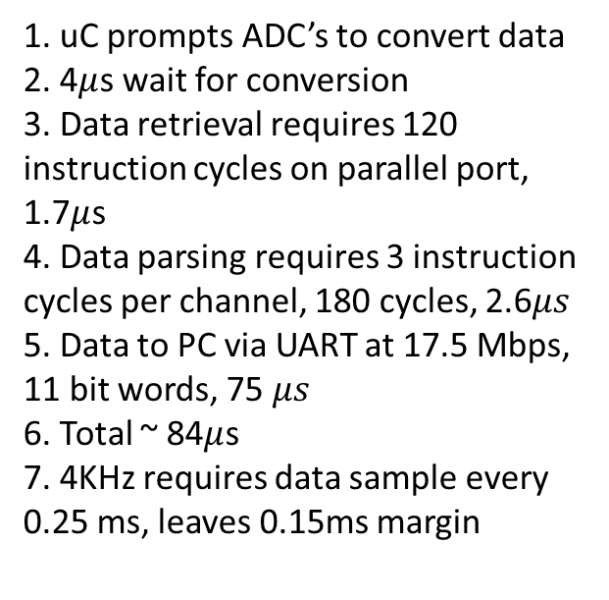
INITIALIZATION:
Description
1. uC prompts ADC’s to convert data
2. 4$μ$s wait for conversion
3. Data retrieval requires 120 instruction cycles on parallel port, 1.7$μ$s
4. Data parsing requires 3 instruction cycles per channel, 180 cycles, 2.6$μs$
5. Data to PC via UART at 17.5 Mbps, 11 bit words, 75 $μs$
6. Total ~ 84$μ$s
7. 4KHz requires data sample every 0.25 ms, leaves 0.15ms margin
User runs exe
Chirp μC
Run from an executable off a USB stick.
Created using libraries:
cx freeze
tkinter
pyserial
Chirp μC to standby
Open GUI
Standby for commands
Project Overview
Structure
Electrical Hardware
Software
Testing
Conclusion

Slide 92
RUN TEST:
User selects Start Button
Chirp μC
Description
Run from GUI button “Start.”
Created using libraries:
pyserial
matplotlib
numpy
Chirp μC to gather data
Display alert window
Bad
Gather Data from Serial Port
Check limits
Good
Run FFT on nth data pull
Repeat until stop command
Plot Power Spectral Density
Project Overview
Structure
Electrical Hardware
Software
Testing
Conclusion

Slide 93
STOP TEST:
Description
User selects Stop Button
Chirp μC
Run from GUI button “Stop.”
Created using libraries:
pyserial
matplotlib
numpy
xlsxwriter
Chirp μC to standby
Output plots and raw data to an excel file
Save raw data to csv
Prompt user to save report
yes
no
Open Report file
Reset GUI
Project Overview
Structure
Electrical Hardware
Software
Testing
Conclusion

Slide 94
RESET GUI:
Description
Test terminates
Chirp μC
Run automatically after a test has been stopped.
Created using libraries:
pyserial
tkinter
Chirp μC to standby
Flush data
Reset GUI
Standby for commands
Project Overview
Structure
Electrical Hardware
Software
Testing
Conclusion

Slide 95
SELECTED LIBRARIES:
Library: | Function: | Python Release:
cx freeze | Converts Python to MS Executable | 3.1 – 3.4
tkinter | GUI generation | 3.1 – 3.5
pyserial | Serial port communications | 3.0 – 3.4
numpy | Scientific computing package including FFT | 3.2 – 3.4
matplotlib | Graphic plotting capability | 3.1 – 3.4
xlsxwriter | Data read and write to MS excel format | 3.1 – 3.5
Conclusion
Testing
Software
Electrical Hardware
Structure
Project Overview

Slide 96
PROJECT BUDGET – What We Want:
Total Budget: $5000
Total Spent:
$ 6277
Project Overview
Structure
Electrical Hardware
Software
Testing
Conclusion

Slide 97
PROJECT BUDGET – Surrey Pays for Vibe:
Total Budget: $5000
Total Spent:
$ 3200
Project Overview
Structure
Electrical Hardware
Software
Testing
Conclusion

Slide 98
PROJECT BUDGET – EEF Approved
Total Budget: $5000
Total Spent:
$ 4332
Project Overview
Structure
Electrical Hardware
Software
Testing
Conclusion

Slide 99
PROJECT BUDGET – Worst Case:
Total Budget: $5000
Total Spent:
$ 4853.50
Project Overview
Structure
Electrical Hardware
Software
Testing
Conclusion

Slide 100


Numerical Modeling
Challenges of using ANSYS to do in-depth analysis
Good material properties
Correct use of loads, boundary conditions, and element types
Limitations of educational license (<40k elements)

Slide 101
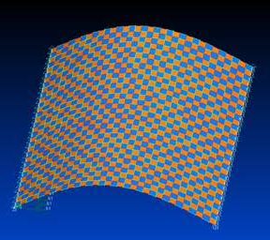
Material Properties
Using honeycomb properties provided from Hexcel corp.
Orthotropic
Carbon Fiber more difficult
Found that fabric orthotropic properties are not enough to describe buckling
Used M55J fiber properties as generated by AJ Gemer, using a modeled simulated layup of alternating uni-directional cells=
LASP HyperDust Instrument CDR

Slide 102
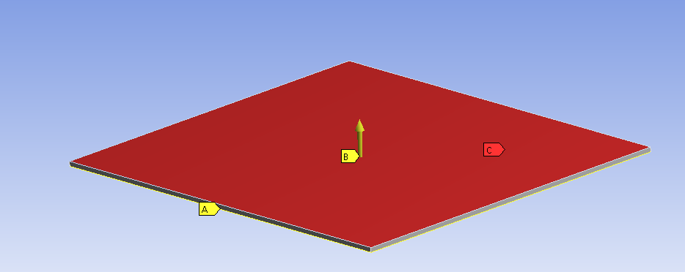
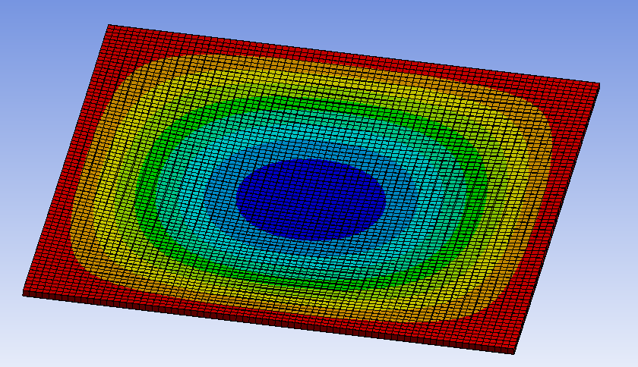
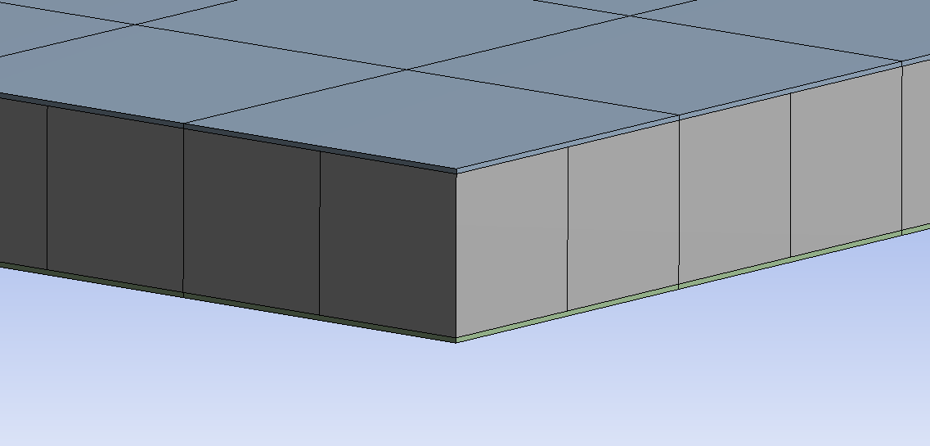
Applications of Boundary Conditions and Loads
Boundary Conditions are TBD on final model
For feasibility, used simple supports and uniform load distribution on middle panel
Used shell elements for face skin, 3d elements for core
Concerned about 1-element through t
Deflections within 10% of analytical solution
Stresses within ~25%

Slide 103
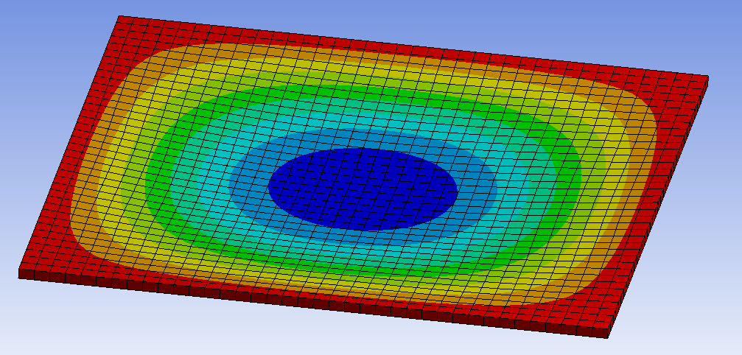
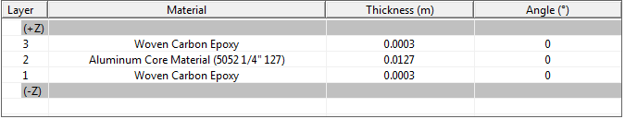
Getting around educational license
Having 3 layers of elements quickly creates too many elements.
Can use 1 layer of shell element (2D) and describe it’s material properties with a layered section
Deformation still within 16% of analytical
Stresses show ~no change

Slide 104
Material Properties
Using honeycomb properties provided from Hexcel corp.
Orthotropic
Carbon Fiber more difficult
Found that fabric orthotropic properties are not enough to describe buckling
Used M55J fiber properties as generated by AJ Gemer, using a modeled simulated layup of alternating uni-directional cells=
LASP HyperDust Instrument CDR

Slide 105
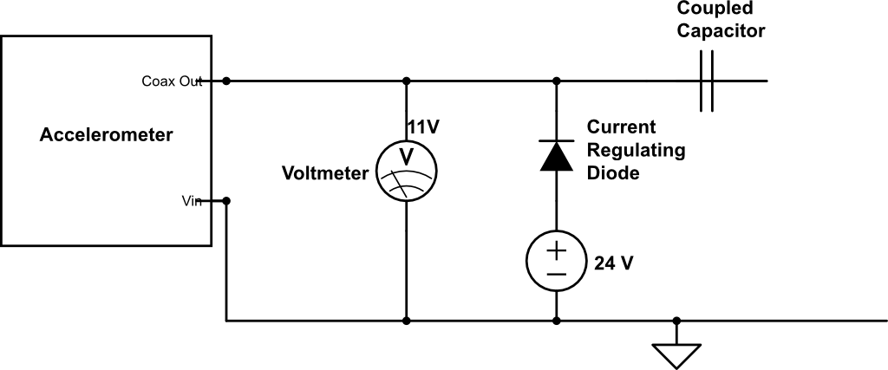
CHARGE AMPLIFIER:
Project Overview
Structure
Electrical Hardware
Software
Testing
Conclusion

Slide 106
Why 60 Channels?
Used as an estimate from Surrey until we are able to perform a modal analysis test on the structure.
Project Overview
Structure Overview
Electrical Hardware Overview
Structure Feasibility
Electrical Hardware Feasibility
Software Overview
Software Feasibility
Testing

Slide 107
TITLE:
Project Overview
Structure Overview
Electrical Hardware Overview
Structure Feasibility
Electrical Hardware Feasibility
Software Overview
Software Feasibility
Testing

Slide 108
TITLE:
Project Overview
Structure Overview
Electrical Hardware Overview
Structure Feasibility
Electrical Hardware Feasibility
Software Overview
Software Feasibility
Testing

Slide 109
Project Overview
Structure Overview
Electrical Hardware Overview
Structure Feasibility
Electrical Hardware Feasibility
Software Overview
Software Feasibility
Testing

Slide 110
TITLE:
Thing 1: | Thing 2: | Thing 3: | Thing 4: | Thing 5:
Project Overview
Structure Overview
Electrical Hardware Overview
Structure Feasibility
Electrical Hardware Feasibility
Software Overview
Software Feasibility
Testing

Slide 111
SECTION HEADER

